Slide 1
Group Technology Architecture
Cyber Security Tutorial Introduction
Maahir Aziz
Security Architect – Standard Bank Group
Deven Gengan
Enterprise Architect – Standard Bank Group
Martin Havenga
Segment Architect – Standard Bank Group

Slide 2
Contents
Pre-requisites and machine setup
Cyber Security Introduction
Hacking Introduction
Kali Linux Introduction
Anonymize Presence
Proxychains: concept, setup, test
Reconnaissance
Nmap with proxychains
Learning map
Questions

Slide 3
Pre-requisites
Virtualbox installation
Get the software from virtualbox.org, correct version for your OS
Follow the setup as per the website
Kali installation
Get the OS download from kali.org
Can install on virtualbox with a minimum of 20 GB. Recommend 40 GB so that you have space for updates and can use as a second OS
If you want to, you can partition your hard drive and install as a second OS, detailed instructions on the kali website

Slide 4
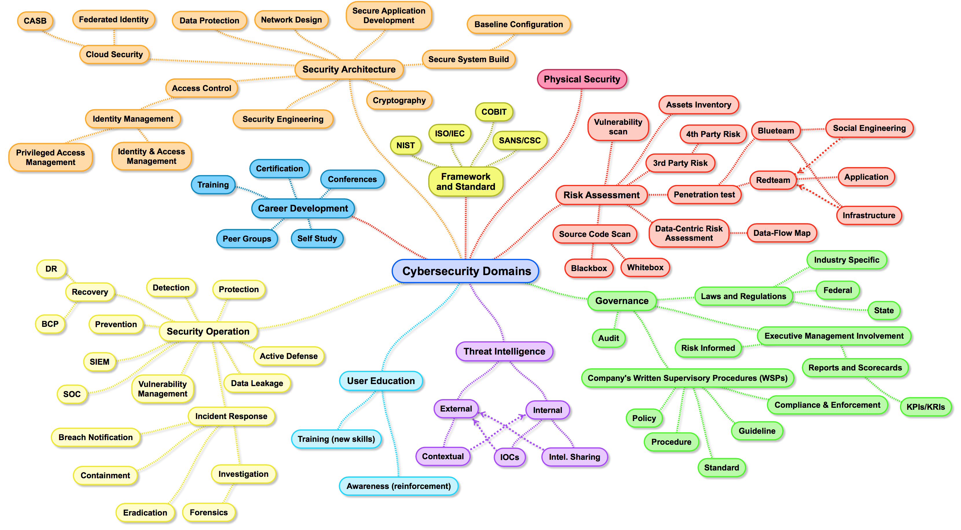
Cyber Security - Introduction

Slide 5
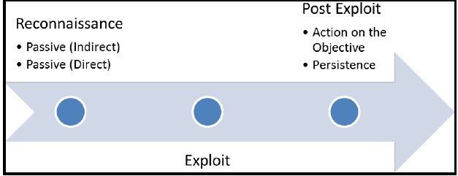
Hacking - Introduction
Anonymize presence
Have a goal in mind
Generally no set method of conducting hacking activities as it limits creativity ☺
Attacker kill chain : a concept that includes the steps taken by an adversary when they attack.
Far from linear
Multiple over time, overlapping etc
Recon, exploit, post-exploit [Cloppert]
As the good guys, the fundamentals of these activities are to determine the RISK
RISK – Threat – Vulnerability
Mitigate – No control - Treat

Slide 6
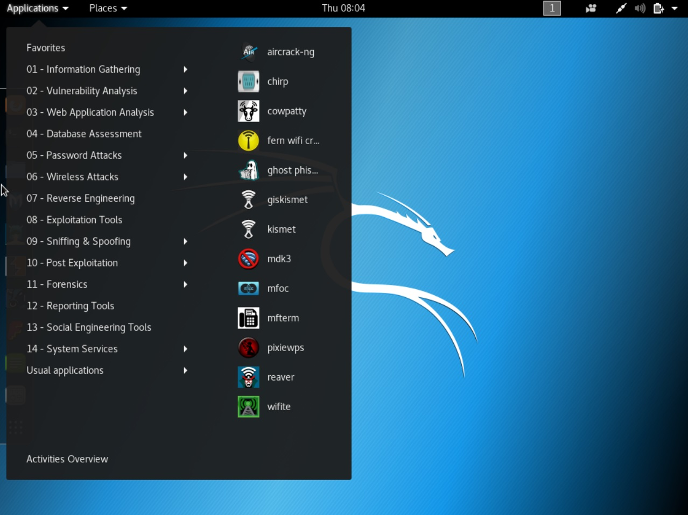
Kali Linux – Quick Introduction
Kali Linux is a Debian-based Linux distribution aimed at advanced Penetration Testing and Security Auditing. Kali contains several hundred tools which are geared towards various information security tasks, such as Penetration Testing, Security research, Computer Forensics and Reverse Engineering. Kali Linux is developed, funded and maintained by Offensive Security, a leading information security training company.

Slide 7
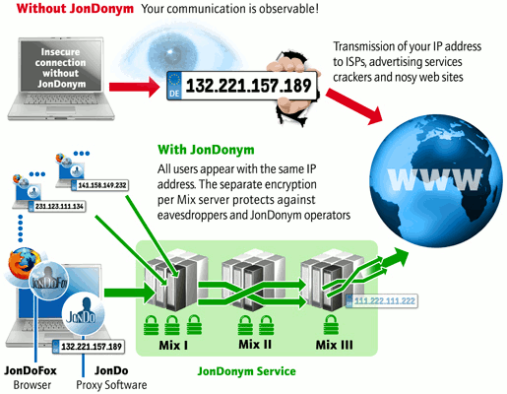
Anonymize Presence - Proxychains
It’s a proxyfier, allowing TCP and DNS tunnelling through proxies
Supports: HTTP, SOCKS4 and SOCKS5 proxy servers
Proxy chain: user defined list of proxies chained together
/etc/proxychains.conf
Dynamic chaining
Random chaining

Slide 8
Anonymize Presence - Proxychains
Step 1: Look at the proxychains files
Run the command in terminal : locate proxychains
Step 2: Setup the config file
Run the command in terminal: leafpad /etc/proxychains.conf
then
edit “add proxy here”
by adding a few from www.socks-proxy.net and www.sslproxies.org/
and comment out the last line “127.0.0.1 9050” since we are not using tor.

Slide 9
Anonymize Presence - Proxychains
Step 3: Test proxychains
Run traceroute to any website and note the trace, do it by preceding the command with the proxychains command and then do it without. You will observe different IP addresses

Slide 10
Recon - Nmap
Example
Test nmap on scaneme.nmap.org
Do it with the proxychain command !
Network Mapper is a security scanner used to discover hosts and services on a network, thus building a “map” of the network.
Features
Host Discovery
Port Scanning
Version Detection
OS Detection
Scriptable interaction with the target via Nmap Scripting Engin

Slide 11
Learning Map
Lesson 2: Weaponize-Aircrack, USB Wifi adapter with packet injection
Lesson 3: Exploit-Evil Twin Attack

